Slide 1
STAT 7900: Special Topic:
Causal Analysis
Instructor
Dhrubajyoti Ghosh
KENNESAW STATE UNIVERSITY
STAT 7900

Slide 2
Recap Slides
1 QUESTION
2 COUNTERFACTUALS
3 GRAPHS
4 INTERVENTIONS
What would happen
if we intervened?
Define Y(1), Y(0)
and the causal estimand
Use a DAG to decide
what must be adjusted for
Use an SCM and do(·)
to define intervention worlds
Identification comes before estimation.
Today: SCM and why randomization makes the identification step unusually transparent.

Slide 3
Recap Slides
DESCRIPTIVE
PREDICTIVE
CAUSAL
What is happening?
What will happen?
What would happen
if we intervened?
How does blood pressure differ
between smokers and non-smokers?
Can age, BMI, and smoking
predict future blood pressure?
Would smoking cessation
lower blood pressure?
The scientific question determines the analysis.

Slide 4


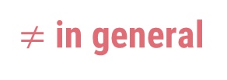
Recap Slides
OBSERVED ASSOCIATION
CAUSAL EFFECT
$≠$ in general
$$E[Y(1)] − E[Y(0)]$$
$$E[Y | T = 1] − E[Y | T = 0]$$
C
T
Y
A common cause C creates the backdoor path $T ← C → Y$.
Correlation can be a mixture of causal and noncausal association.

Slide 5


Recap Slides
Fundamental problem: only one world is observed; the other is counterfactual.
WORLD 1
WORLD 0
T = 1
T = 0
Potential outcome: Y(1)
Potential outcome: Y(0)
Individual effect$: Yᵢ(1) − Yᵢ(0)$
ATE: $E[Y(1) − Y(0)]$
Causal inference learns about missing counterfactuals.
Causal inference learns about missing counterfactuals.

Slide 6




Recap Slides
ATE
ATT
ATC
CATE(x)
$$E[Y(1) − Y(0)]$$
$$E[Y(1) − Y(0) | T=1]$$
$$E[Y(1) − Y(0) | T=0]$$
$$E[Y(1) − Y(0) | X=x]$$
Average effect in the
target population
Effect among those
actually treated
Effect among those
actually untreated
Effect in a covariate-defined
subgroup
Same data + different estimand → different causal question.

Slide 7
Four Assumptions
CONSISTENCY
EXCHANGEABILITY
Observed Y equals the potential outcome
under the treatment actually received.
After conditioning on the right X, treatment
carries no extra information about Y(t).
POSITIVITY
SUTVA / NO INTERFERENCE
Within relevant X strata, both treatment
options have positive probability.
Treatment is well defined and one unit’s
treatment does not alter another’s outcome.
Failure: no overlap / unsupported counterfactual.
Failure: hidden versions or spillovers.
These assumptions are not fully testable from the observed data alone.

Slide 8

Three Building Blocks
CHAIN
FORK
COLLIDER
X $→$ Z $→$ Y
X ← Z → Y
X → Z ← Y
Open by default.
Blocked when conditioned on Z.
Open by default.
Blocked when conditioned on Z.
Blocked by default.
Open when conditioned on Z.
Conditioning behaves differently in the collider.

Slide 9
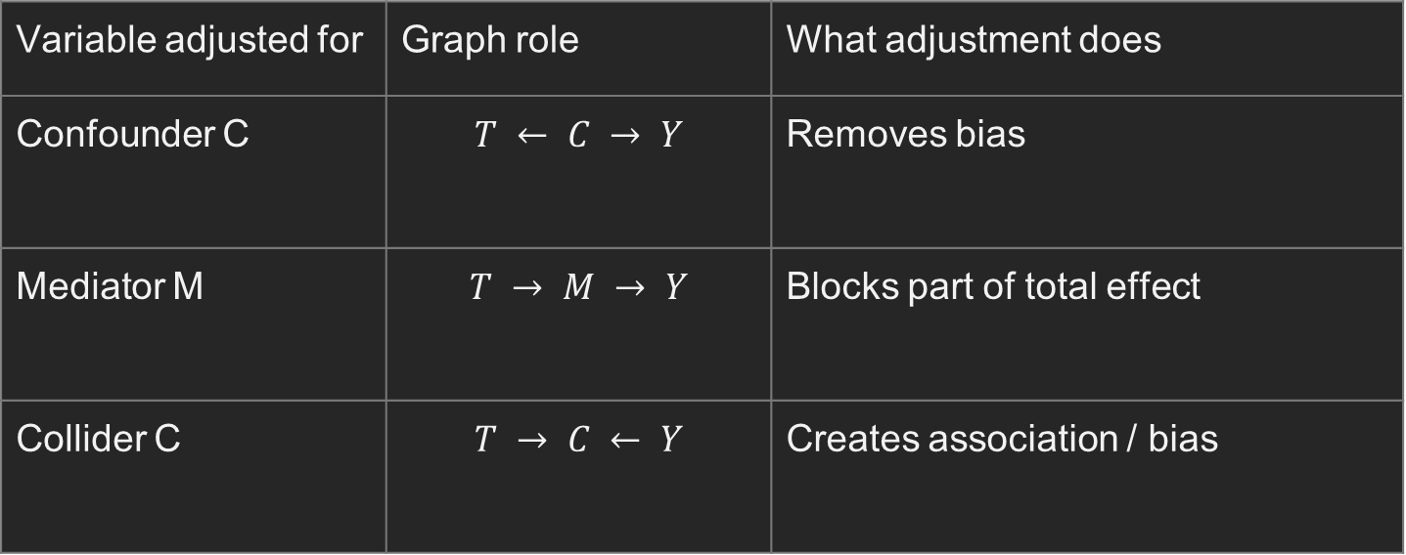
Recap
Variable adjusted for | Graph role | What adjustment does
Confounder C | $$T ← C → Y$$ | Removes bias
Mediator M | $$T → M → Y$$ | Blocks part of total effect
Collider C | $$T → C ← Y$$ | Creates association / bias
Regression syntax cannot tell you which causal role a covariate has.

Slide 10
Recap
R with dagitty
What R is checking
library(dagitty)
g <- dagitty("dag {
T [exposure]
Y [outcome]
Age -> BP; Age -> T
BP -> DM; BP -> T; BP -> Y
DM -> T; DM -> BP3
T -> BP3; T -> Y
BP3 -> Adh; BP3 -> Y
Pref -> Adh; Adh -> Y
}")
adjustmentSets(g, type = "minimal",
effect = "total")
Minimal set = { BP, DM }
BP is required to block
T ← BP → Y.
DM blocks the remaining path
T ← DM → BP3 → Y.
Age is not needed once BP is
already in the set.
Do not adjust for BP3 or Adh:
they are post-treatment.
Output: { BP, DM }

Slide 11


Slide 12
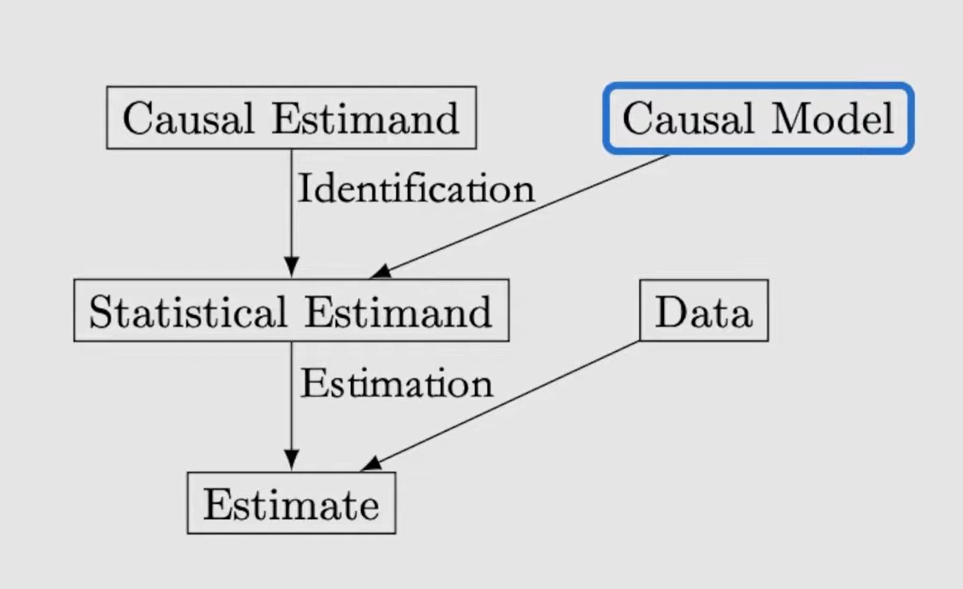
Structural Causal Models (SCM)

Slide 13
Structural Causal Models (SCM)
From a causal picture to a model of how the world generates variables
DAG = causal map
SCM = causal map + generating rules
We will learn how to represent an intervention such as “force treatment = 1.”

Slide 14
Structural Causal Models (SCM)
A DAG already tells us:
SCM adds something new:
which variables directly cause which.
which paths are causal or noncausal.
what we may need to adjust for.
a rule for how each variable is generated.
a precise meaning for “intervene”.
a way to define the same person under different treatment choices.
SCM makes “what if we changed T?” mathematically precise.

Slide 15
Example
Clinical question:
Does an intensive blood-pressure treatment lower systolic BP after 3 months?
C
baseline severity
T
Y
treatment
3-month BP

Slide 16
Example
C → T
Baseline severity can influence which treatment is chosen.
C → Y
Baseline severity can also influence the outcome.
T → Y
Treatment can causally change the outcome.
The DAG gives direction, but not yet the actual rule for generating T or Y.

Slide 17
Example
The graph does not tell us:
How strongly does severity affect treatment choice?
How strongly does treatment change blood pressure?
What other background factors affect treatment or outcome?
Exactly what should we change when we say “give treatment to everyone”?
SCM supplies those generating rules.

Slide 18
SCM
1
Generate baseline severity C
2
Generate treatment T using C + other factors
3
Generate outcome Y using T, C + other factors
Each recipe says: “given the direct causes of this variable, how is this variable produced?”

Slide 19
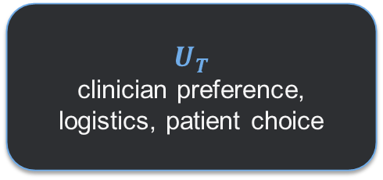
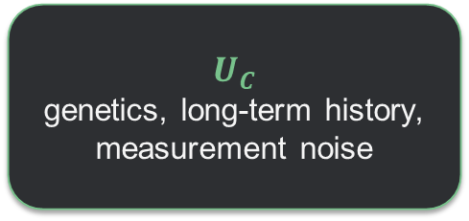
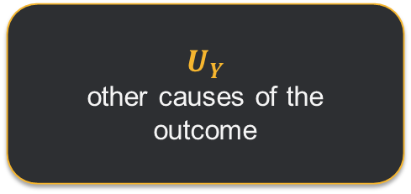
U Variables
U means background factors not explicitly represented as nodes in our simple DAG.
$$U_{C}$$
genetics, long-term history, measurement noise
$$U_{T}$$
clinician preference, logistics, patient choice
$$U_{Y}$$
other causes of the outcome
We use U because no model includes every cause in the universe.
Important: a U variable can be measured or unmeasured in reality. Here it simply means “outside the simplified system we drew.”

Slide 20
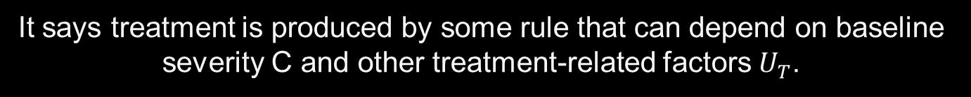


Treatment Assignment
$$T := f_{T}(C, U_{T})$$
This does NOT mean treatment is random.
It says treatment is produced by some rule that can depend on baseline severity C and other treatment-related factors $U_{T}$.
$f_{T}$ = Treatment Decision Rule

Slide 21
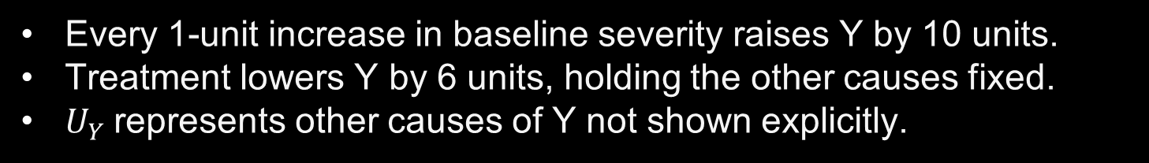
Outcome
$$Y = 120 + 10C − 6T + U_{Y}$$
One possible numerical rule:
Every 1-unit increase in baseline severity raises Y by 10 units.
Treatment lowers Y by 6 units, holding the other causes fixed.
$U_{Y}$represents other causes of Y not shown explicitly.

Slide 22
What makes an SCM causal
A regression can describe association.
An SCM makes an additional scientific claim:
If we externally change one variable, the other generating rules remain the rules of the system.
That is what allows the model to answer intervention questions.

Slide 23


Key Operation: Intervention
Normal observational world:
Intervention world:
$$T = f_{T}(C, U_{T})$$
$$T := 1$$
Treatment follows the usual decision process.
We replace the treatment rule and force treatment to 1.
Everything else in the SCM stays the same.

Slide 24
Do Calculus
“Set treatment to 1 from outside the system.”
do(T = 1)
Do not let baseline severity decide T.
Do not let clinician preference decide T.
Simply assign T = 1, then let the rest of the model run.
Before intervention
After do(T = 1)
C
T
C
T=1
Y
Y

Slide 25
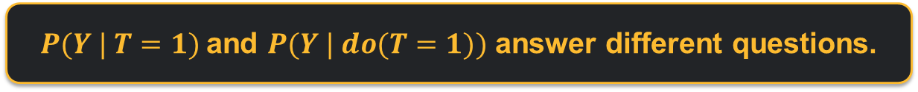
Intervention vs Conditioning
Conditioning: T = 1
Look at the people who happened to receive treatment.
Their baseline characteristics may differ from untreated people.
Intervention: do(T = 1)
Force treatment to 1 for the target population.
The usual treatment-selection process is bypassed.
$P(Y | T=1)$and $P(Y | do(T=1))$ answer different questions.

Slide 26
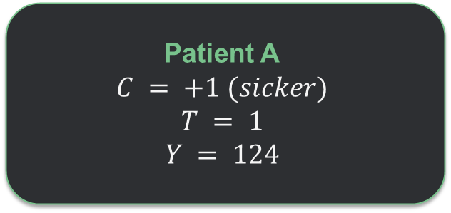


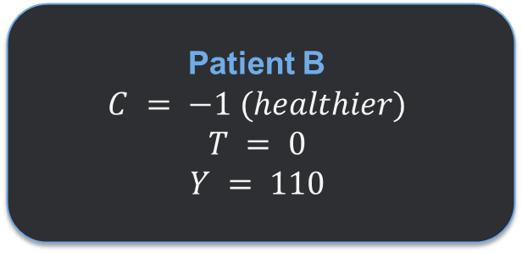
Numerical Example
Outcome rule:
$$Y = 120 + 10C − 6T$$
Patient A
$$C = +1 (sicker)$$
Patient B
$$C = −1 (healthier)$$
Observed comparison:
$$124 − 110 = +14$$
But treatment itself lowers Y by 6. Baseline severity created the misleading observed difference.

Slide 27
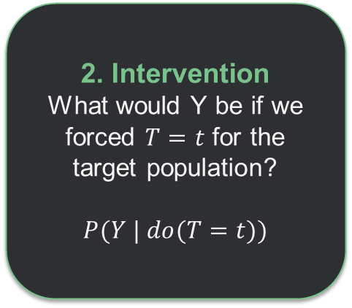
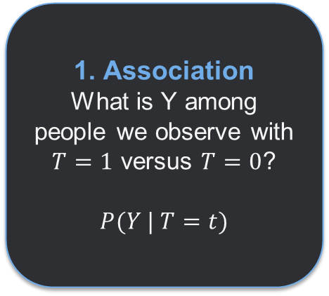
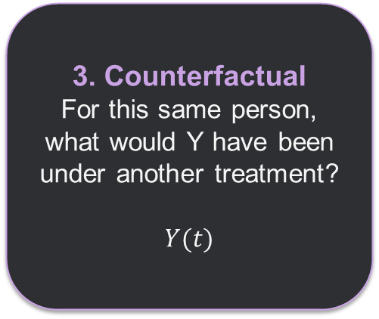
Three Different Questions
1. Association
What is Y among people we observe with $T=1$ versus $T=0$?
$P(Y | T=t)$
2. Intervention
What would Y be if we forced $T=t$ for the target population?
$P(Y | do(T=t))$
3. Counterfactual
For this same person, what would Y have been under another treatment?
$Y(t)$
SCM gives one framework for all three, but they are not the same question.

Slide 28
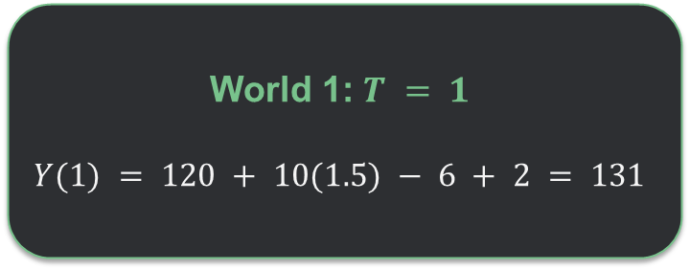

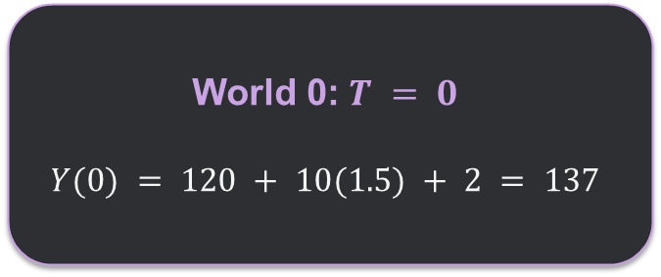
Counterfactual: Same person, Different treatment
Suppose one person has:
$$C = 1.5 U_{Y} = 2$$
Keep these person-specific background factors fixed.
World 1: $T = 1$
$$Y(1) = 120 + 10(1.5) − 6 + 2 = 131$$
World 0: $T = 0$
$$Y(0) = 120 + 10(1.5) + 2 = 137$$
Y(1) − Y(0) = −6

Slide 29
g-Computation does the same thing
1
set T = 1 and predict Y
2
set T = 0 and predict Y
3
average the difference
That procedure is trying to emulate the two intervention worlds described by the SCM.
The estimation model is not the SCM itself, but the intervention logic is the same.

Slide 30
Simulation: Build Data from SCM
P(T=1 | C) = logistic(1.2C)
Y = 120 + 10C − 6T + ε
C ~ Normal(0,1)
Interpretation:
Sicker patients (larger C) are more likely to receive treatment.
Sicker patients also have higher Y.
Treatment truly lowers Y by 6 units.
True intervention effect = −6

Slide 31
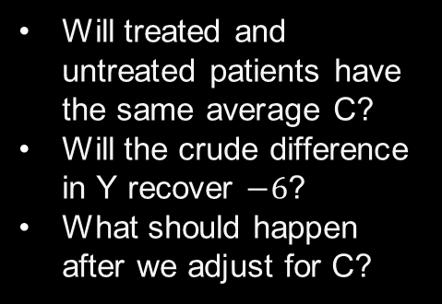
Simulation: Build Data from SCM
set.seed(7900)
n <- 5000
C <- rnorm(n)
p <- plogis(1.2*C)
T <- rbinom(n, 1, p)
eps <- rnorm(n, sd = 5)
Y <- 120 + 10*C - 6*T + eps
dat <- data.frame(C, T, Y)
Before fitting anything, predict:
Will treated and untreated patients have the same average C?
Will the crude difference in Y recover $−6$?
What should happen after we adjust for C?

Slide 32
Simulation: Build Data from SCM
Observed mean Y
Crude observed difference:
118.77
118.77 − 115.25 = +3.52
115.25
But the true treatment effect is −6.
Wrong sign!
T = 0
T = 1
One simulated realization; exact sample numbers vary slightly with the random-number generator.

Slide 33
Simulation adjust for Common Cause C
fit_crude <- lm(Y ~ T, data = dat)
fit_adj <- lm(Y ~ T + C, data = dat)
coef(fit_crude)["T"]
# about +3.5
coef(fit_adj)["T"]
# about -6.0
Crude model
T coefficient ≈ +3.5
Adjusted model
T coefficient ≈ −6.0
The adjusted model recovers the truth here because the simulation satisfies the required assumptions and the outcome rule is correctly represented.

Slide 34
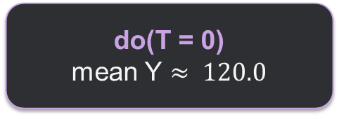
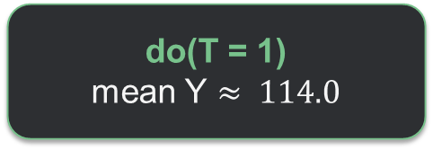
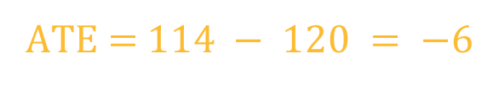
Simulation creates two interventions
# keep each person's C and eps fixed
Y1 <- 120 + 10*C - 6*1 + eps
Y0 <- 120 + 10*C - 6*0 + eps
mean(Y1) # about 114.0
mean(Y0) # about 120.0
mean(Y1 - Y0) # exactly -6
do(T = 1)
mean Y $≈ 114.0$
do(T = 0)
mean Y $≈ 120.0$
ATE = $114 − 120 = −6$

Slide 35
Real data example: job training and later earnings
Causal question: Does participation in the National Supported Work job-training program increase earnings in 1978?
LaLonde / MatchIt data
What was known before treatment?
614
185
429
Age • education • race • marital status
No high-school degree • earnings in 1974 • earnings in 1975
people
treated
controls
Treatment T: job-training participation
Outcome Y: 1978 earnings (re78)
Call these baseline variables X
These variables may affect both program participation and later earnings.

Slide 36
What does SCM add?
Treated
Control
Crude difference
$6,349
$6,984
−$635
But the groups were already different before treatment
Baseline variable
Treated
Control
Age
25.8
28.0
Married
So −$635 is an observed association, not automatically the causal effect of training.
18.9%
51.3%
Black
84.3%
20.3%
1974 earnings
$2,096
$5,619
1975 earnings
$1,532
$2,466

Slide 37

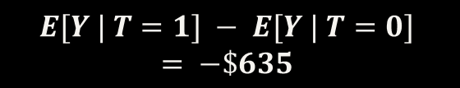
What do observed data say?
A plausible causal story
What we observed
Baseline X
$$E[Y | T=1] − E[Y | T=0]$$
Earnings Y
Training T
What we want causally
$$E[Y | do(T=1)] − E[Y | do(T=0)]$$
SCM tells us what “force training” versus “force no training” means. It does not make −$635 causal; assumptions and appropriate adjustment are still needed.

Slide 38
Next
SCM gave us a precise target:
E[Y | do(T=1)] − E[Y | do(T=0)]
Next question:
When can we learn that intervention effect from the data we actually observe?
Next: randomized experiments and identification

Slide 39
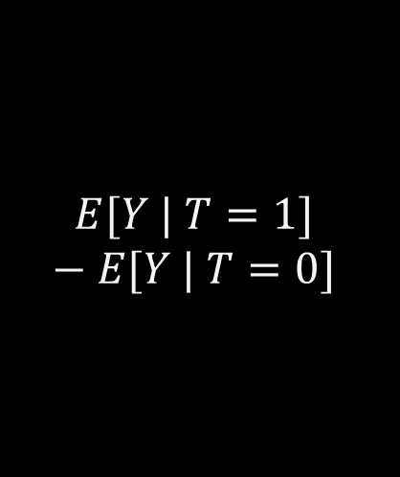
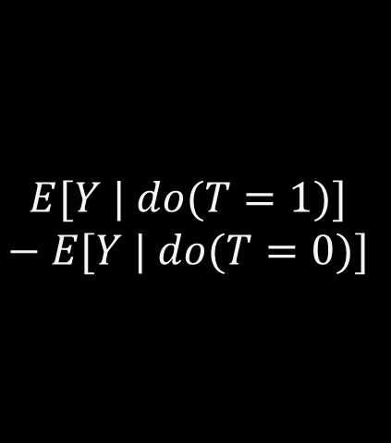
Bridge
SCM gave us a target
Observed data give us
Identification asks
$$E[Y | do(T=1)]$$
$$− E[Y | do(T=0)]$$
$$E[Y | T=1]$$
$$− E[Y | T=0]$$
When are these two comparisons equal?

Slide 40
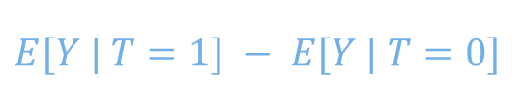

Identification Question
Causal estimand
Observed distribution
Identification
$$E[Y(1)] − E[Y(0)]$$
$$E[Y | T=1] − E[Y | T=0]$$
A set of assumptions that lets us rewrite the causal estimand using the observed-data distribution.
Identification is not an estimator. It is the logic that tells us what observable quantity represents the causal target.

Slide 41
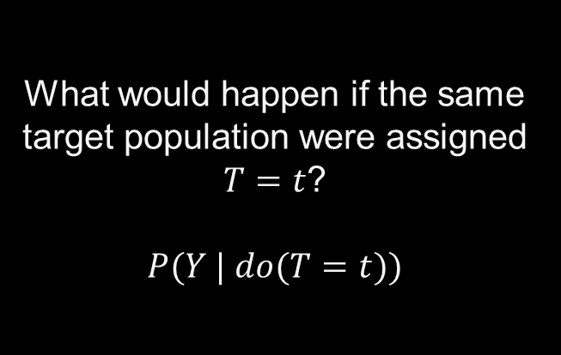
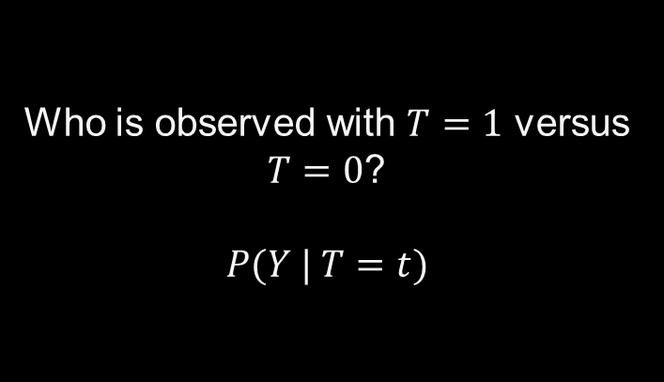
Association vs Intervention
Observed association
Intervention distribution
Who is observed with $T=1$ versus $T=0$?
$$P(Y | T=t)$$
What would happen if the same target population were assigned $T=t$?
$$P(Y | do(T=t))$$
Randomization is a design that can make these distributions coincide for the causal question of interest.

Slide 42
When can we replace $do(T=t)$ by $T=t$
P(Y | do(T=t)) = P(Y | T=t)
This equality is NOT true automatically.
One route
Another route
Other routes
Randomize treatment assignment.
In observational data, condition on a sufficient adjustment set.
IV, front-door, DiD, synthetic control, etc.

Slide 43
Randomized Experiment: Core Idea
Treatment
Eligible units
Random assignment
Observe outcomes
Control
The treatment mechanism is deliberately created by the investigator rather than chosen by prognosis, preference, or policy.

Slide 44
Randomized Experiment: Core Idea
Observational treatment assignment
Randomized treatment assignment
Treatment T
Treatment T
Severity C
Severity C
Outcome Y
Outcome Y
T ← C → Y
No systematic C → T arrow

Slide 45
Randomized Experiment in Potential Outcome
$$T ⟂ \{Y(1), Y(0), X\}$$
Meaning
Consequence
The assigned treatment does not depend on potential outcomes or baseline covariates.
Treated and control units are valid stand-ins for each other’s missing counterfactual outcomes, on average over randomization.
This is exchangeability created by design.

Slide 46
ATE Identification in a Randomized Trial
$$ATE = E[Y(1)] − E[Y(0)]$$
↓ under randomization + consistency
$$ATE = E[Y | T=1] − E[Y | T=0]$$
Design result
Analysis result
A causal estimand becomes an observed mean contrast.
Difference in sample means is the natural estimator.
Randomization solves the confounding problem. It does not eliminate sampling uncertainty.

Slide 47
Randomization does not eliminate ALL assumptions
Consistency
Positivity
Treatment versions must match the intervention being defined.
Each unit must have a nonzero chance of assignment to relevant arms.
No interference
Outcome measurement
One unit’s assigned treatment should not alter another unit’s outcome for a standard individual-level estimand.
Outcomes must be measured comparably enough to support the target contrast.
Randomization primarily creates exchangeability. The rest of the causal story still matters.

Slide 48
Design vs Analysis
Design stage
Analysis stage
• Define target population
• Define treatment versions
• Choose randomization scheme
• Pre-specify outcomes and estimands
• Protect against interference / contamination
• Plan sample size and follow-up
• Estimate arm-specific outcome means
• Compare according to estimand
• Quantify uncertainty
• Adjust for baseline covariates if appropriate
• Handle missing outcomes / noncompliance carefully
• Report effect + interval, not only p-value
In causal inference, strong design often does more work than a complicated analysis.

Slide 49
Randomized Trial Example
Population
Treatment
Outcome
Adults with uncontrolled hypertension meeting trial eligibility criteria.
T=1: new drug once daily
T=0: placebo / usual care
Randomize 1:1
Systolic blood pressure after 4 weeks.
Target: average treatment effect in trial participants.

Slide 50
Assignment is NOT same as treatment received
Nonadherence, crossover, access barriers, clinical decisions
Randomized assignment Z
Treatment received D
Outcome Y
Randomization guarantees exchangeability for assignment Z. It does not automatically randomize treatment actually received D.

Slide 51
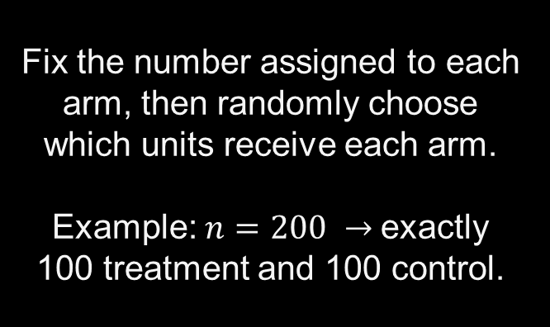
Complete Randomization
Design
Why use it?
Fix the number assigned to each arm, then randomly choose which units receive each arm.
Example: $n=200 →$exactly 100 treatment and 100 control.
• Simple
• Exact arm sizes
• Transparent assignment mechanism
• Basis for many randomization-based results
$$Pr⁡(T_{i}=1)=100/200=0.5$$

Slide 52
Bernoulli Randomization
Design
Difference from Complete
Each unit is randomized independently, e.g.
Tᵢ ~ Bernoulli(0.5)
The final treatment-arm size is random. You might end with 96 treated and 104 controls, or 107 and 93, etc.
$$\text{Both are randomized designs; they induce slightly different assignment distributions.}$$

Slide 53
Blocked / Stratified Randomization
Randomize within important baseline groups rather than across everyone at once.
Treatment
Age < 60
Randomize
Benefit
Improves balance on pre-specified prognostic variables and can improve precision.
Control
Age ≥ 60
Treatment
Randomize
Control
Stratification is a design choice, not a post hoc repair for confounding.

Slide 54
Cluster Randomization
Sometimes we randomize groups rather than individuals.
Clinic 1
Clinic 2
Clinic 3
Clinic 4
Treatment arm
Treatment arm
Control arm
Control arm
To reduce contamination, simplify implementation, or because the intervention operates at group level.
Why?
Analysis must account for within-cluster correlation; the effective sample size is smaller than the raw number of individuals suggests.

Slide 55
Matched Pair Randomization
Form pairs of similar units first, then randomize one unit in each pair to treatment.
Pair 1: A
Pair 1: B
1 treated
1 control
Useful when
A strong prognostic variable is known and matching can make within-pair comparisons much more precise.
Pair 2: A
Pair 2: B
1 treated
1 control
Pair 3: A
Pair 3: B
1 treated
1 control
Pair 4: A
Pair 4: B
1 treated
1 control

Slide 56
What randomization guarantees
Known assignment probabilities
We know how treatment was generated.
No systematic confounding by baseline variables
Assignment is independent of baseline prognosis by design.
Unbiased treatment contrast over repeated randomizations
The design centers the difference-in-means estimator at the causal effect.
These are properties of the assignment mechanism, not promises about one realized dataset.

Slide 57
What randomization does not guarantee
Exact covariate balance
No missing outcomes
Chance imbalance can occur.
People can still drop out or miss visits.
Perfect adherence
No interference
Assigned treatment may not be taken.
People or clusters can affect each other.
Generalizability
Large sample precision
Trial volunteers may differ from target population.
A small RCT can be unbiased but very noisy.

Slide 58
A Baseline Balance Table
Variable
Control
Treatment
Difference
Question
Age, years
58.2
57.6
+0.6
Should we “fix” every visible baseline difference?
Baseline SBP
128.4
131.6
−3.2
Female
52%
49%
+3 pp
Diabetes
21%
18%
+3 pp
Use pre-specified covariate adjustment for precision, not data-driven fishing for variables with small baseline p-values.

Slide 59
Exchangeability vs Covariate Balance
Exchangeability
Observed balance
A statement about the assignment mechanism and potential outcomes.
In a correctly randomized experiment, it holds by design before we look at the data.
A descriptive feature of one realized randomization.
It can look imperfect even when exchangeability is valid.

Slide 60
SATE vs PATE
Sample Average Treatment Effect (SATE)
Population Average Treatment Effect (PATE)
Average causal effect for the units actually enrolled in this experiment.
Finite-sample target.
Average causal effect for a broader target population from which trial participants are viewed as a sample.
Requires a sampling / transport story.
Randomization identifies the treatment contrast inside the trial. Generalization beyond the trial is a separate problem.

Slide 61

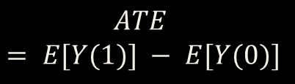

From Identification to Estimation
Causal target
Randomization + consistency
Estimation
$$ATE = E[Y(1)] − E[Y(0)]$$
$$≈{\overline{Y}}_{1} −{\overline{Y}}_{0}$$
$$= E[Y | T=1] − E[Y | T=0]$$
Identification told us WHICH observed-data quantity equals the causal estimand.
Estimation tells us how to learn that quantity from a finite sample.
Next, we finish the randomized-trial story: point estimate → uncertainty → inference.

Slide 62



The Difference-in-Means Estimator
$$\hat{τ}={\overline{Y}}_{1} −{\overline{Y}}_{0}$$
$${\overline{Y}}_{1}$$
$${\overline{Y}}_{0}$$
$$\hat{τ}$$
Average observed outcome among participants assigned to treatment.
Average observed outcome among participants assigned to control.
Estimated average treatment effect in the trial sample.
For a continuous outcome and a simple two-arm randomized trial, this is the natural estimator.
Simple analysis is enough because the design already did the confounding control.

Slide 63
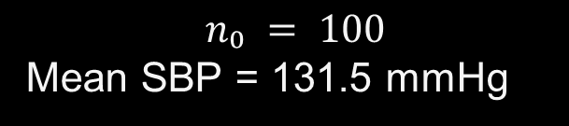
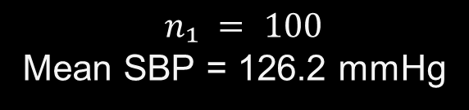
Worked Example: Continuous Outcome
Outcome: systolic blood pressure after 4 weeks
Treatment arm
Control arm
$$n₁ = 100$$Mean SBP = 126.2 mmHg
$n₀ = 100$
Mean SBP = 131.5 mmHg
$$\hat{τ}= 126.2 − 131.5 = −5.3 mmHg$$
Interpretation: assignment to the new treatment lowered mean 4-week SBP by 5.3 mmHg in this trial sample.
Always report the direction, magnitude, and units of the effect.

Slide 64
Why does Difference in Means Work?
Treatment group
Control group
Difference
Randomization makes this group a valid sample of the potential outcomes under treatment.
Randomization makes this group a valid sample of the potential outcomes under control.
Subtracting the two arm means estimates the average causal contrast.
The estimator is simple because exchangeability came from the randomization mechanism.

Slide 65




Standard Error of the Difference in Means
$$SE(\hat{τ}) =\sqrt{ ( s₁²/n₁ + s₀²/n₀ )}$$
$$s₁ and s₀$$
$$n₁ and n₀$$
$$SE(\hat{τ})$$
Sample standard deviations within the treatment and control arms.
Numbers of participants observed in the two treatment arms.
Typical sampling variability of the estimated difference in means.
More outcome variability increases SE; larger sample sizes decrease SE.

Slide 66
Worked Example: 95% Confidence Interval
Suppose $\hat{τ} = −5.3$mmHg and $SE(\hat{τ}) = 1.8 mm$Hg.
$$95\% CI ≈\hat{τ}± 1.96 × SE(\hat{τ})$$
$$= −5.3 ± 1.96(1.8)$$
$$= (−8.8, −1.8) mmHg$$
The data are compatible with a moderate reduction in SBP; the interval excludes 0 in this example.
Report the effect estimate together with its interval, not only a p-value.

Slide 67
What Does a 95% Confidence Interval Mean?
Correct repeated-sampling idea
Common incorrect statement
If we repeated the trial many times using the same procedure, about 95% of similarly constructed intervals would contain the true target effect.
“There is a 95% probability that the true effect lies in this particular interval.”
In the frequentist framework, the fixed effect is not assigned a probability after the interval is observed.
Confidence describes the long-run performance of the interval procedure.

Slide 68
Hypothesis Test and p-value
$H₀: τ = 0$ versus $H₁: τ ≠ 0$
A p-value asks: if the null hypothesis were true, how unusual would an estimate at least this extreme be under the assumed analysis?
Small p-value
Large p-value
Data are difficult to reconcile with H₀ under the analysis assumptions.
Does NOT prove “no effect”; the trial may simply be imprecise.
Effect size + confidence interval usually communicates more than the p-value alone.

Slide 69
Randomization Inference
Inference can come directly from the randomization mechanism.
1
2
3
4
Assume a sharp null: treatment changes no participant’s outcome.
Re-randomize treatment labels using the same design used in the trial.
Recompute the difference in means for each random assignment.
Compare the observed difference with the randomization distribution.
This test uses the experiment’s actual assignment mechanism rather than a model for outcomes.

Slide 70
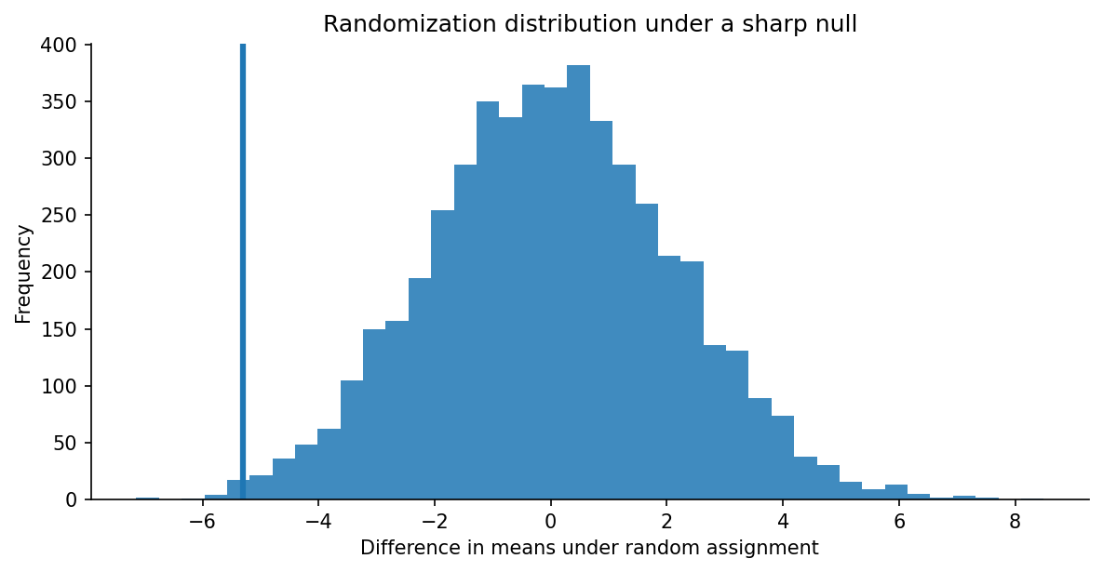
Where Is the Observed Effect?
If −5.3 lies far in the tail of the null distribution, such a difference is unusual under no treatment effect.
Randomization inference turns “what else could random assignment have produced?” into a formal test.

Slide 71

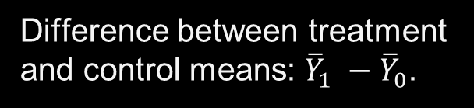

Where Is the Observed Effect?
$$Yᵢ = β₀ + β₁Tᵢ + εᵢ$$
$$β₀$$
$$β₁$$
Mean outcome in the control arm when T=0.
Difference between treatment and control means: ${\overline{Y}}_{1} −{\overline{Y}}_{0}$.
$${\hat{β}}_{1}={\overline{Y}}_{1}−{\overline{Y}}_{0}$$
With only a binary treatment indicator, OLS and the raw difference in means are the same estimator.

Slide 72
Where Is the Observed Effect?
Same causal estimate
# Difference in means
mean(dat$Y[dat$T == 1]) -
mean(dat$Y[dat$T == 0])
# Same estimate from regression
fit <- lm(Y ~ T, data = dat)
coef(fit)["T"]
In a simple randomized two-arm trial, both approaches estimate the treatment-control mean difference.
Regression becomes useful when we add covariates, interactions, or design features.
R syntax changes; the estimand should not.

Slide 73
Why adjust for baseline covariates in RCT?
Not to “remove confounding” created by baseline variables.
Reason 1
Reason 2
Reason 3
Improve precision when a baseline variable strongly predicts the outcome.
Account for pre-specified stratification / design variables appropriately.
Protect against chance imbalance without data-driven covariate hunting.
Randomization gives validity; sensible baseline adjustment can give efficiency.

Slide 74

Covariate-Adjusted Analysis: ANCOVA
$$Yᵢ = β₀ + β₁Tᵢ + β₂Xᵢ + εᵢ$$
Example: X = baseline systolic blood pressure.
Treatment coefficient $β₁$
Key restriction
Adjusted treatment-control difference, holding the pre-treatment covariate fixed.
Use baseline/pre-treatment covariates. Do not “adjust” for post-treatment mediators when targeting the total effect.
This connects directly to the DAG logic from earlier lectures.

Slide 75
Adjusted vs Unadjusted
Illustrative results from the same randomized trial
Analysis
Estimate
SE
95% CI
Unadjusted
−5.3
2.1
(−9.4, −1.2)
Adjusted for baseline SBP
−5.1
1.6
(−8.2, −2.0)
The point estimate barely changes, but the adjusted analysis is more precise because baseline SBP explains outcome variation.
Do not choose adjustment variables because they “look imbalanced”; pre-specify important prognostic covariates.

Slide 76
Binary Outcomes: Risk in Each Arm
Suppose the outcome is hospitalization by 30 days.
Treatment
Control
12 hospitalizations / 100
Risk = 0.12 = 12%
20 hospitalizations / 100
Risk = 0.20 = 20%
The two most intuitive causal contrasts are the risk difference and risk ratio.
For binary outcomes, start by estimating the event risk in each randomized arm.

Slide 77
Risk Difference
RD = Risk₁ − Risk₀
$$= 0.12 − 0.20 = −0.08$$
Interpretation: treatment reduced the 30-day hospitalization risk by 8 percentage points in this trial.
Absolute effect
Risk difference is on the probability scale and often easiest to communicate clinically.
−0.08 means 8 fewer events per 100 treated participants, on average.

Slide 78
Risk Ratio
RR = Risk₁ / Risk₀
= 0.12 / 0.20 = 0.60
Interpretation: the hospitalization risk under treatment was 60% of the risk under control.
Relative effect
Equivalently, this example corresponds to a 40% relative risk reduction: 1 − 0.60 = 0.40.
Absolute and relative effects answer different communication questions; report the one tied to your estimand.

Slide 79
Risk Ratio
Interpret first, model second
# Risks by arm
risk1 <- mean(dat$Y[dat$T == 1])
risk0 <- mean(dat$Y[dat$T == 0])
# Risk difference
RD <- risk1 - risk0
# Risk ratio
RR <- risk1 / risk0
When Y is coded 0/1, the sample mean in each arm is the estimated risk.
So, RD and RR can be computed directly before introducing logistic regression or odds ratios.
Keep the estimand visible: risk difference and risk ratio are not the same causal measure.

Slide 80
Summary
Causal
question
Estimator
SE + CI
→
Design /
randomization
→
→
→
Identification
$$E[Y(1)] − E[Y(0)] → E[Y|T=1] − E[Y|T=0] → {\overline{Y}}_{1} −{\overline{Y}}_{0}$$
Next class: estimation when treatment was NOT randomized.
Randomized trials are the clean benchmark. Observational estimation must recreate the missing comparability through assumptions + adjustment.

